Slide 1
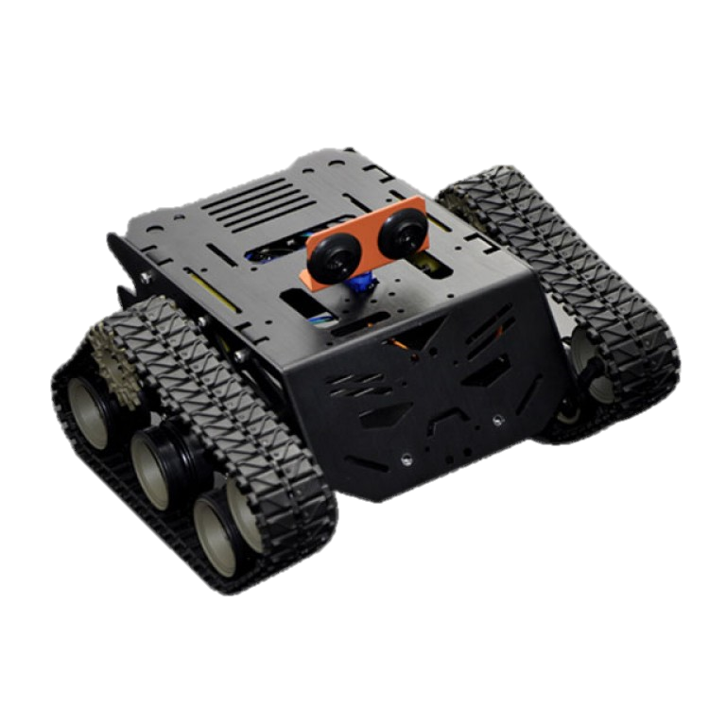
Smart Mobile Car

Slide 2
AGENDA
Project schema
Live Demo
Feature
Work environment
IOT connection
Android APP
Live video stream
Summary

Slide 3



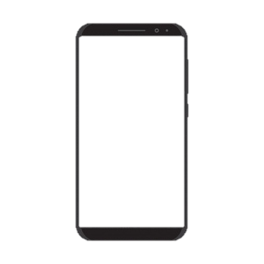
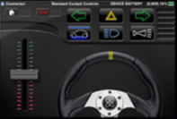
Project scheme
- Client side – Android application.
- Control and management – AWS Services.
Cognito, EC2, IoT, route53, Load Balancer, AWS certificate Manager.
- The things in the system – Raspberry Pi boards.
Controls the camera’s interface.
UV4L server
Notes:
במעבר לשקף הבא תגיד איך החיבור בין באפליקציה לענן

Slide 4
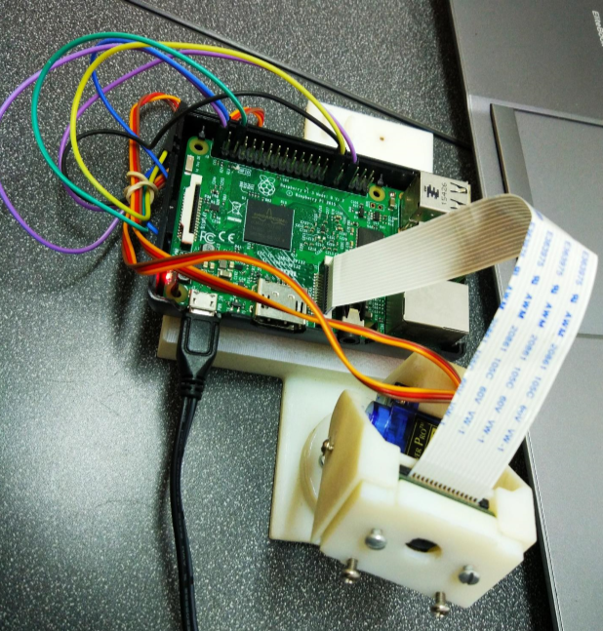
Smart Security Camera
Notes:
Project that we added to our project describe the project 2 min’s

Slide 5

Live Demo

Slide 6






Features
Controlled by smart phone instead of the standard
controller.
Equipped with camera for live streaming .
Can be controlled remotely using the AWS.
Controlled by programmed Raspberry Pi 3.

Slide 7





Work environment
Android Studio
Java
AWS
Python, HTML, Java Script
Raspberry Pi
Python

Slide 8
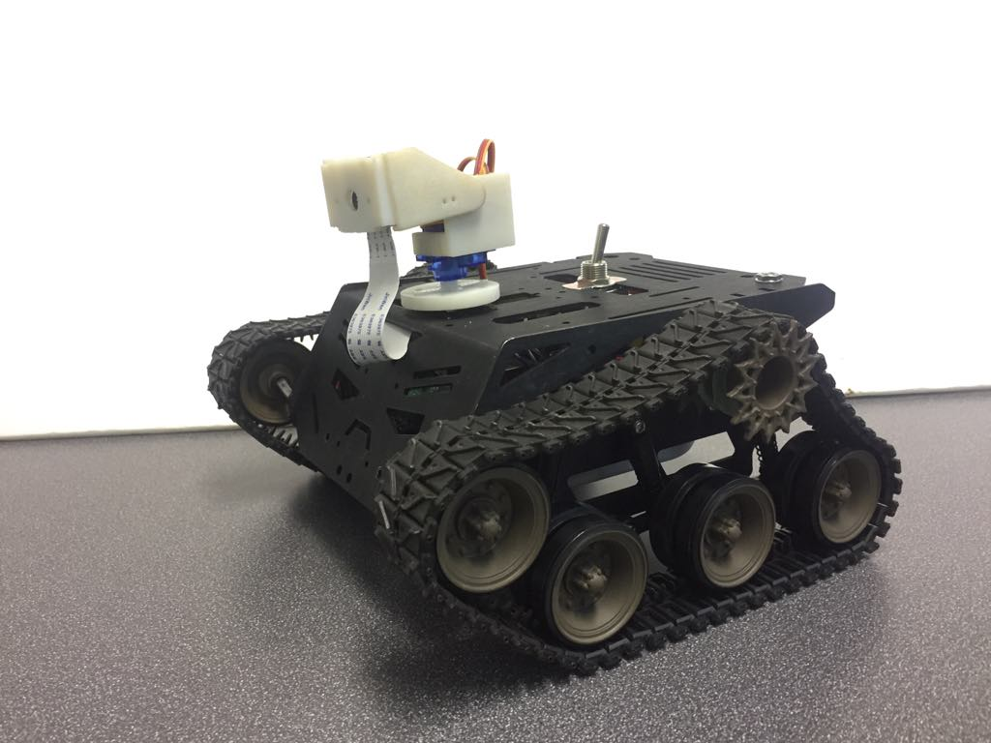
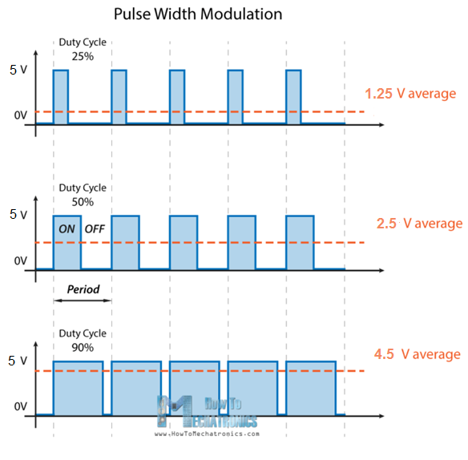
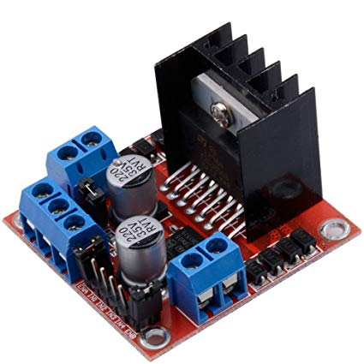
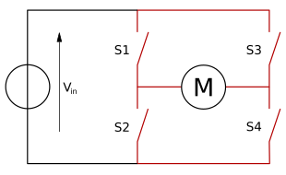
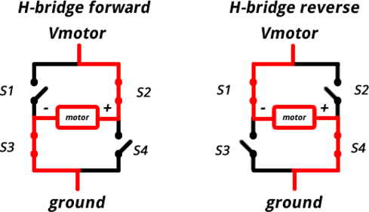
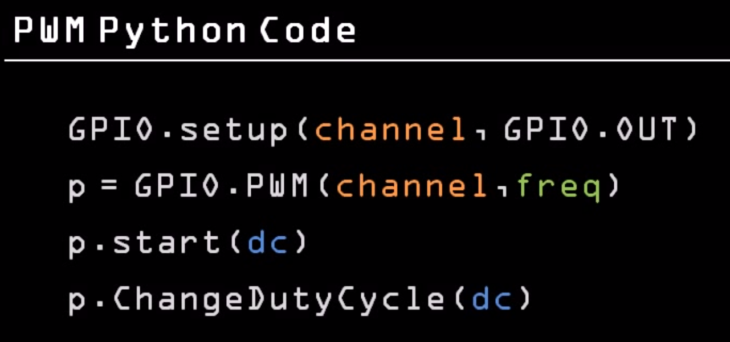
PWM
H-Bridge

Slide 9
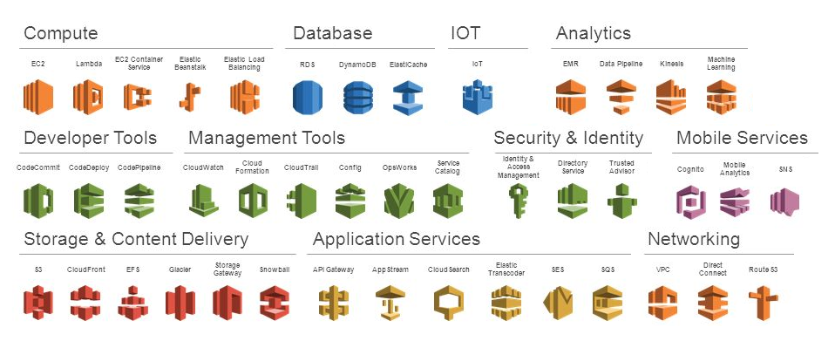
AWS
AWS - Amazon Web Services
More than 70 services.

Slide 10
AWS IoT
Secure, bi-directional communication between Internet-connected things and the AWS cloud.
Makes it easy to build IoT applications that gather, process, analyze and act on data generated by connected devices.

Slide 11


Client Authentication
Cognito
IAM
Credentials are associated with an IAM role.
IAM role - defines a set of permissions to access your AWS resources.
Amazon Cognito generates temporary AWS credentials.

Slide 12

MQTT: Message Queuing Telemetry Transport
- Publish-subscribe-based
- “Lightweight" messaging protocol for use on top of the TCP/IP protocol.
Requires a message broker. The broker is responsible for distributing messages to clients.
Things
MQTT
MQTT
IoT
Client

Slide 13
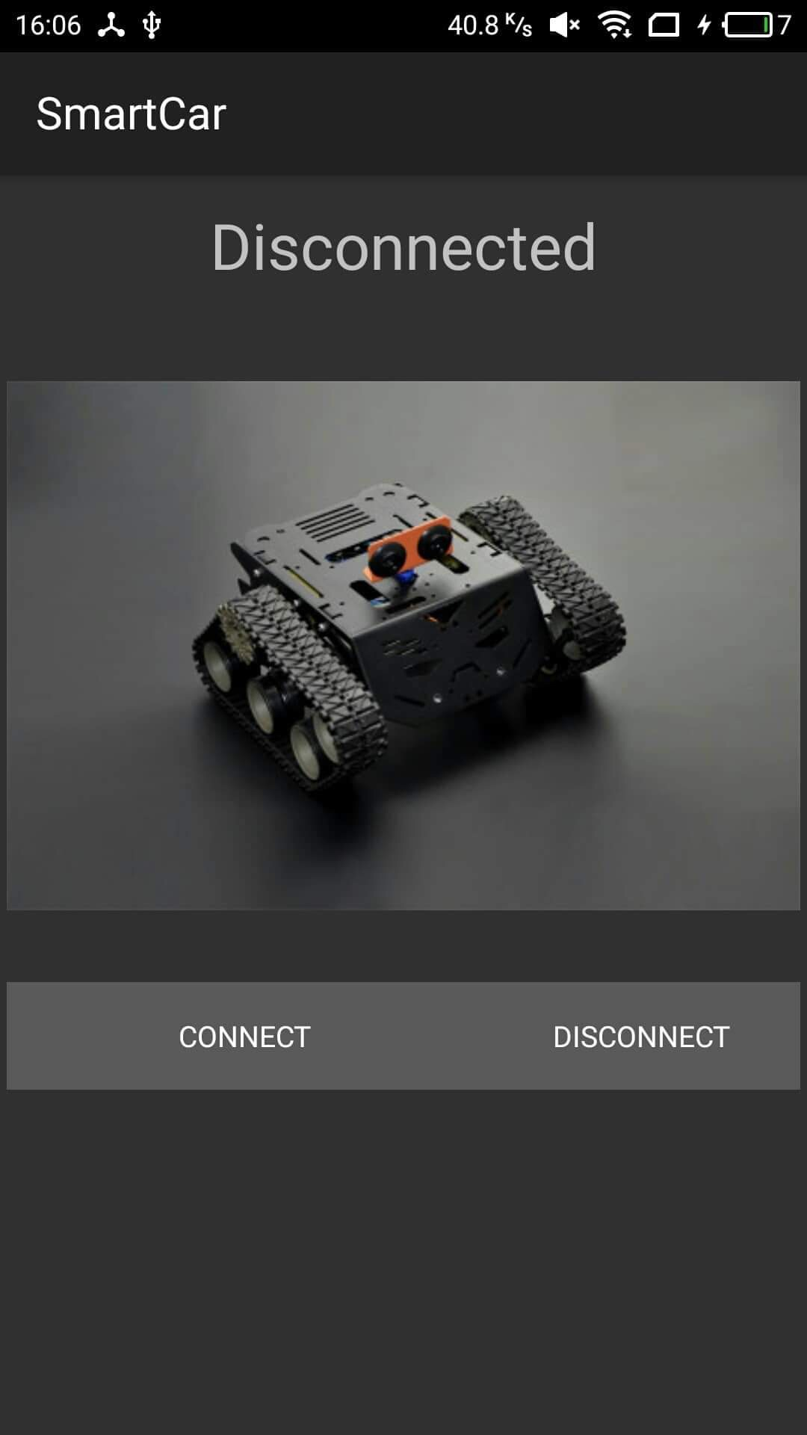
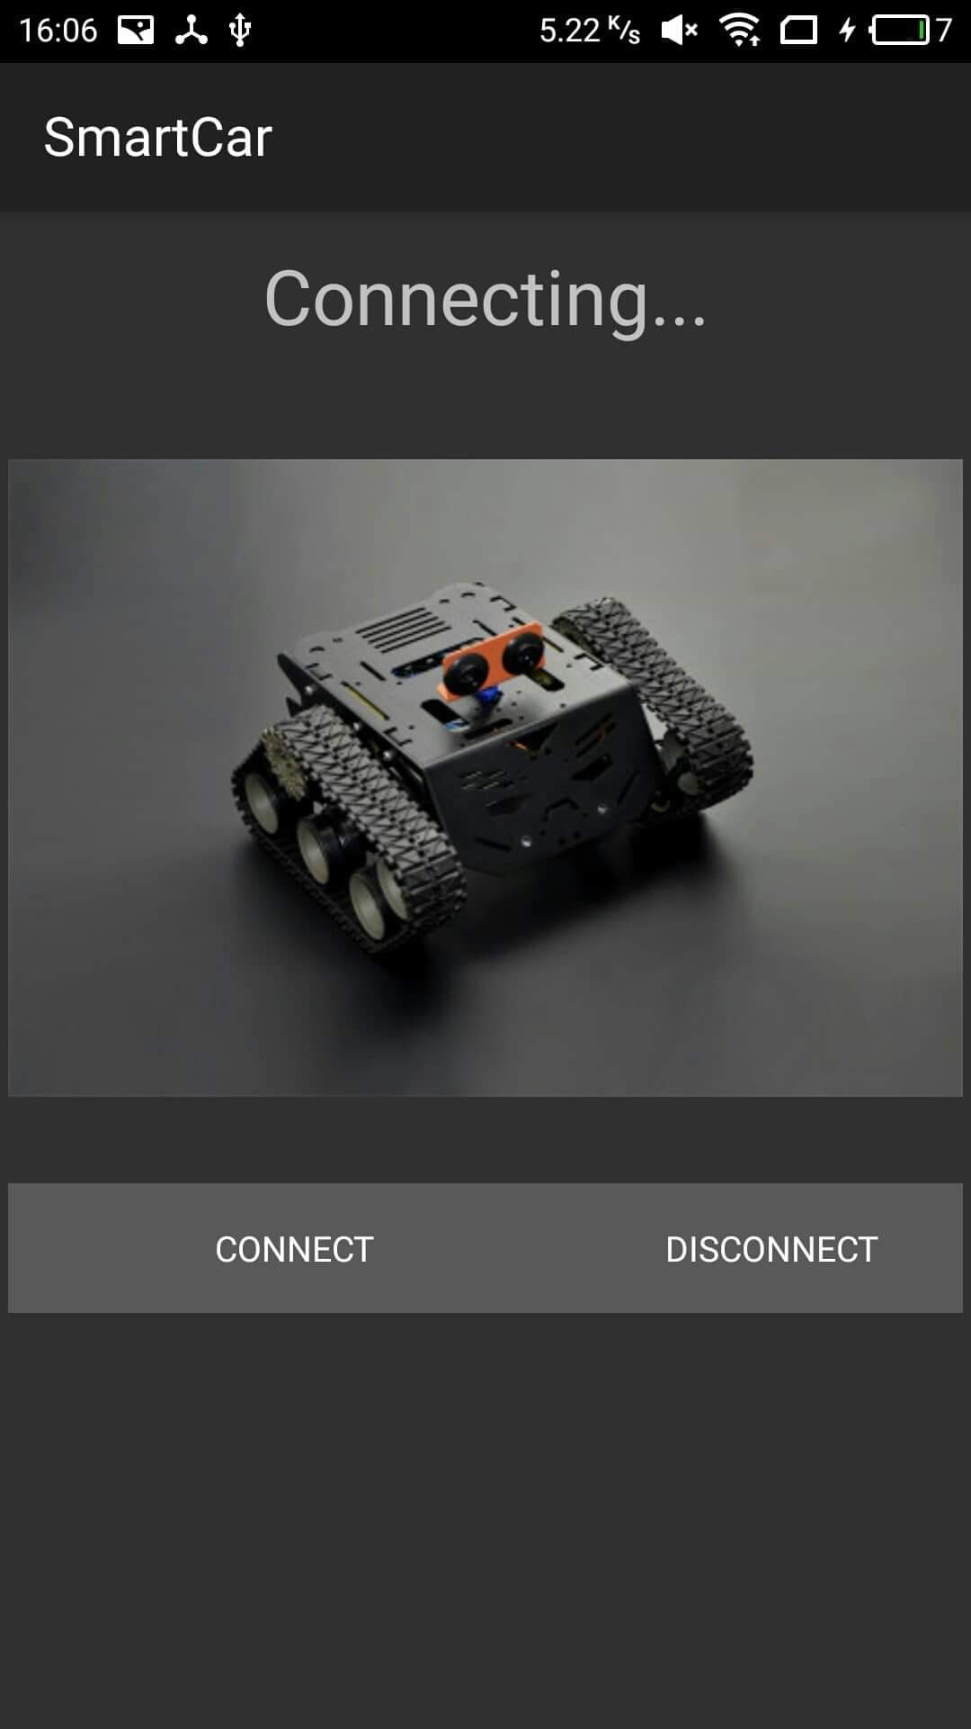
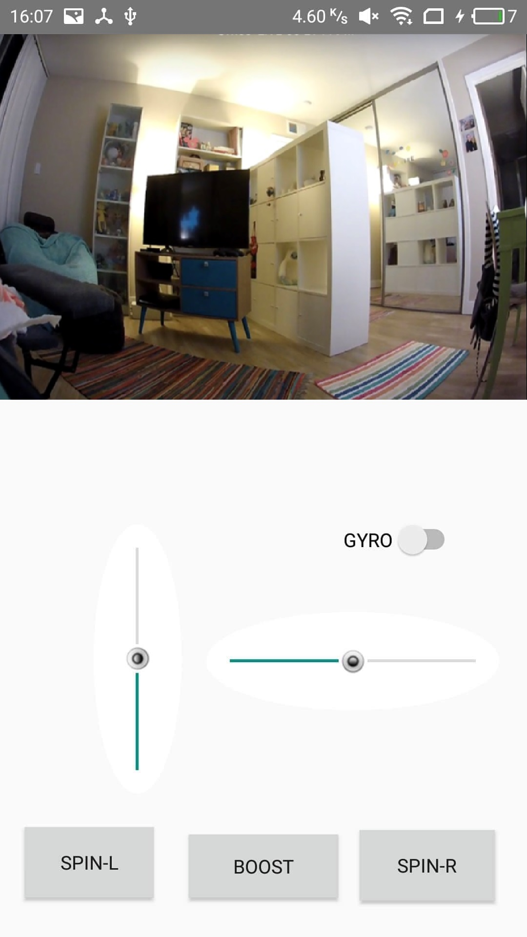
Android Application User Interface
Notes:
ממשק האפליקציה
איך אפשר להשתמש בעיגול כדי לשלוט במכונית
הסבר על הקורדינאטות ואיך אפשר להמיר אותם לקבל פקודות לתנועה חלקה
אפשריות לחישובים

Slide 14
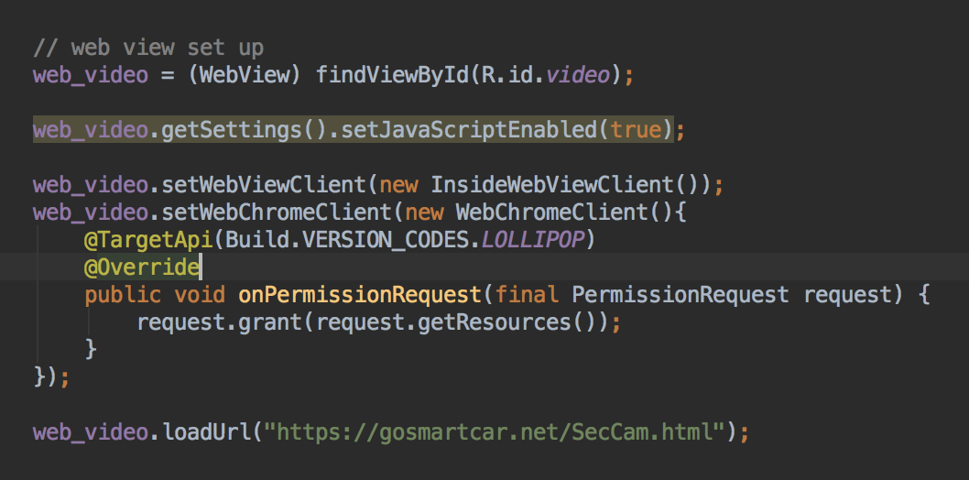
Web view
Notes:
JavaScriptenablesd ,we use html and java script content
additional request for permissions is needed in new android SDK
request the permissions at runtime.

Slide 15
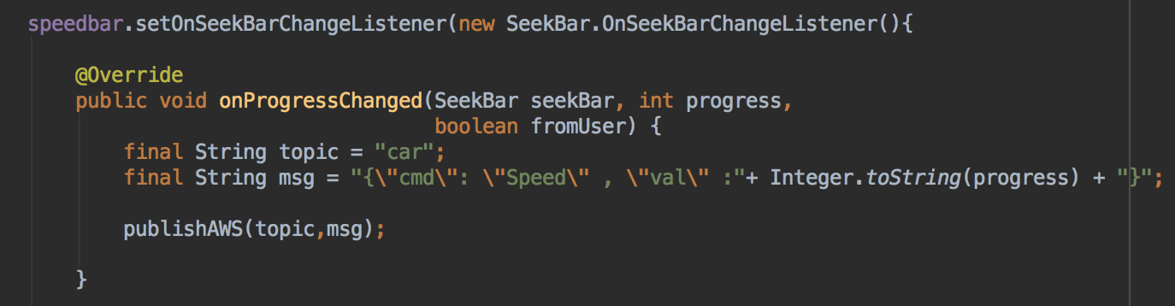

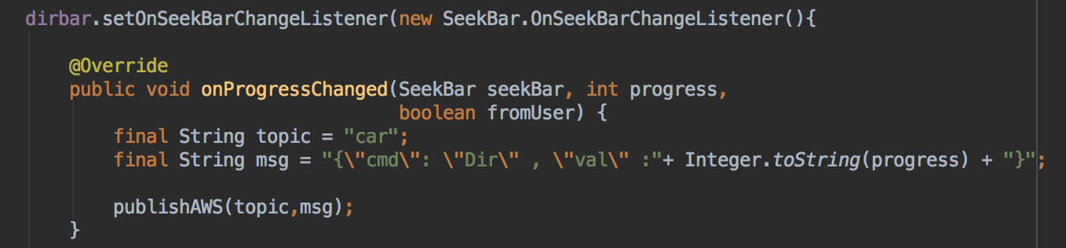
Sending user commands

Slide 16
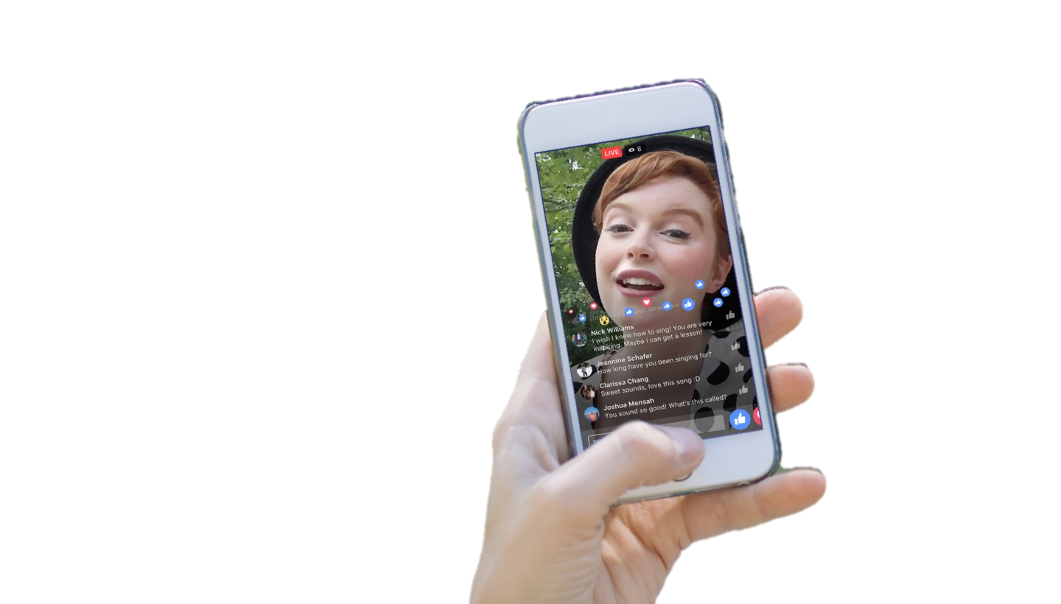
Live video stream
trying different services
Uv4l is the best in performance

Slide 17

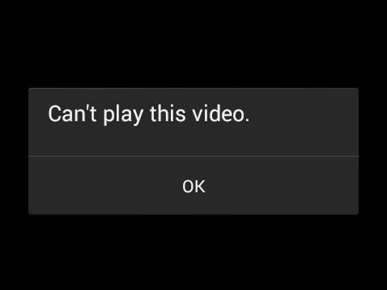
Live video stream
* Running the uv4l on the raspberry pi with H264 format, and streaming on the localhost on port 8080
* Streaming delay to web browsers up to ~100 ms
* H264 Didn’t work well on the android platform, freezes the video
* change to mjpeg and got delay up to ~200 ms.
* We got to stream the video to our android where the two devices where in the same network, how can we obtain that?
Notes:
Streaming to web browser was fine and we get to ~100 ms delay, but when moved to stream through the android phone the video start freezing, we didn’t know why for sure why in the beginning but later we found a out that android does not fully support h264 format, so we had to change the format to Mjpeg where we got with it ~200 ms.

Slide 18
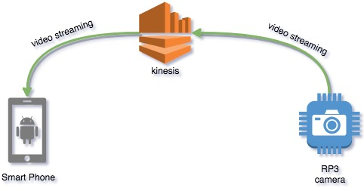
AWS Kinesis
RP3 streams the video to the kinesis
android request the stream from the kinesis
Pros: using reliable and secure service
Cons: ~4 sec delay
Notes:
Final attempt Peer to peer streaming:
That last way we examined was the p2p approach

Slide 19

Need for
SPEED
P2P
We needed fast way to transmit the video with minimum latency
P2P is the solution
But how can two peers talk with each other when they don’t know anything about each other
we need service to share information and start direct streams
Notes:
we need some third party service that will help them share the service information and start direct streams transmission

Slide 20
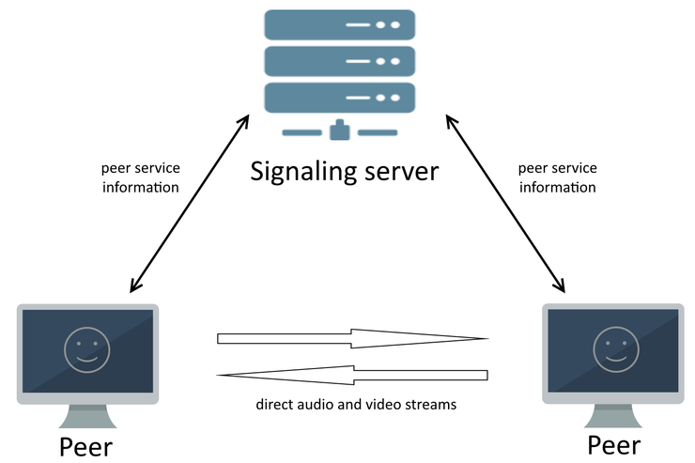
Signaling server
Signaling server is used to let peers share service information to start the peer-to-peer streams transmission.
Peers interact with a signaling
server to share the handshakes
and start a direct peer-to-peer
transmission.
Notes:
The scheme above works perfectly in local area network where each peer has its own IP address and there are no firewalls and routers between them.
But when it goes to the internet, peers can be hidden behind NAT and do not have any information about the external addresses of each other

Slide 21
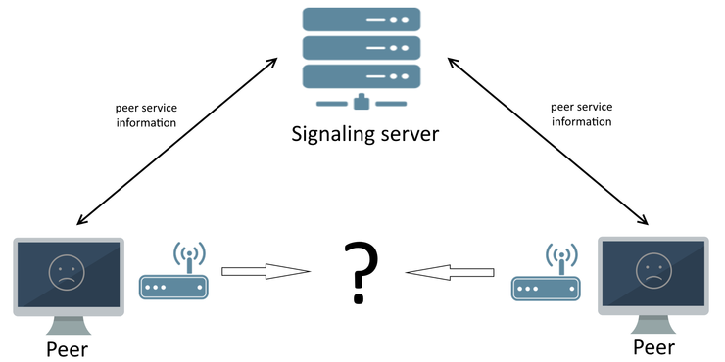
The NAT Problem
NAT cause major problem
for peer-to-peer communication
NAT changes the IP of the peers.
The peer IP will be hidden
to the outside world.

Slide 22
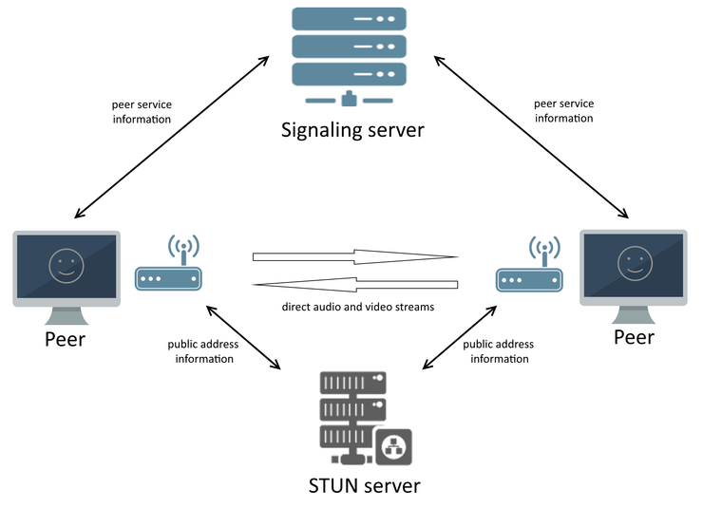
STUN Server
STUN server to let peers know each other's external address
Uv4l has this option
Used google STUN
Notes:
STUN server is used to let peers know each other's external address to start the peer-to-peer streams transmission behind the NAT.
That's the point when we need a STUN server. It allows to detect peers public network addresses and establish a peer-to-peer connection behind a NAT.
We deployed our own signaling server for production usage. Janus

Slide 23

Janus for the rescue
a WebRTC Server
deployed on EC2 Server on AWS
Solves the problems discussed previously
handles all the connection to establish P2P connection

Slide 24
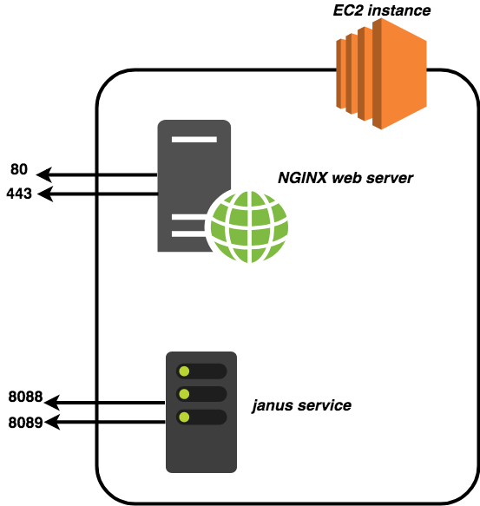
Deployed service on EC2
Notes:
Web server serve the html page.
Janus handles the video related issues.

Slide 25

Live video stream
Things
IoT
MQTT
MQTT
Client
HTTPS
EC2
Notes:
After contacting janus we will have p2p video streaming

Slide 26
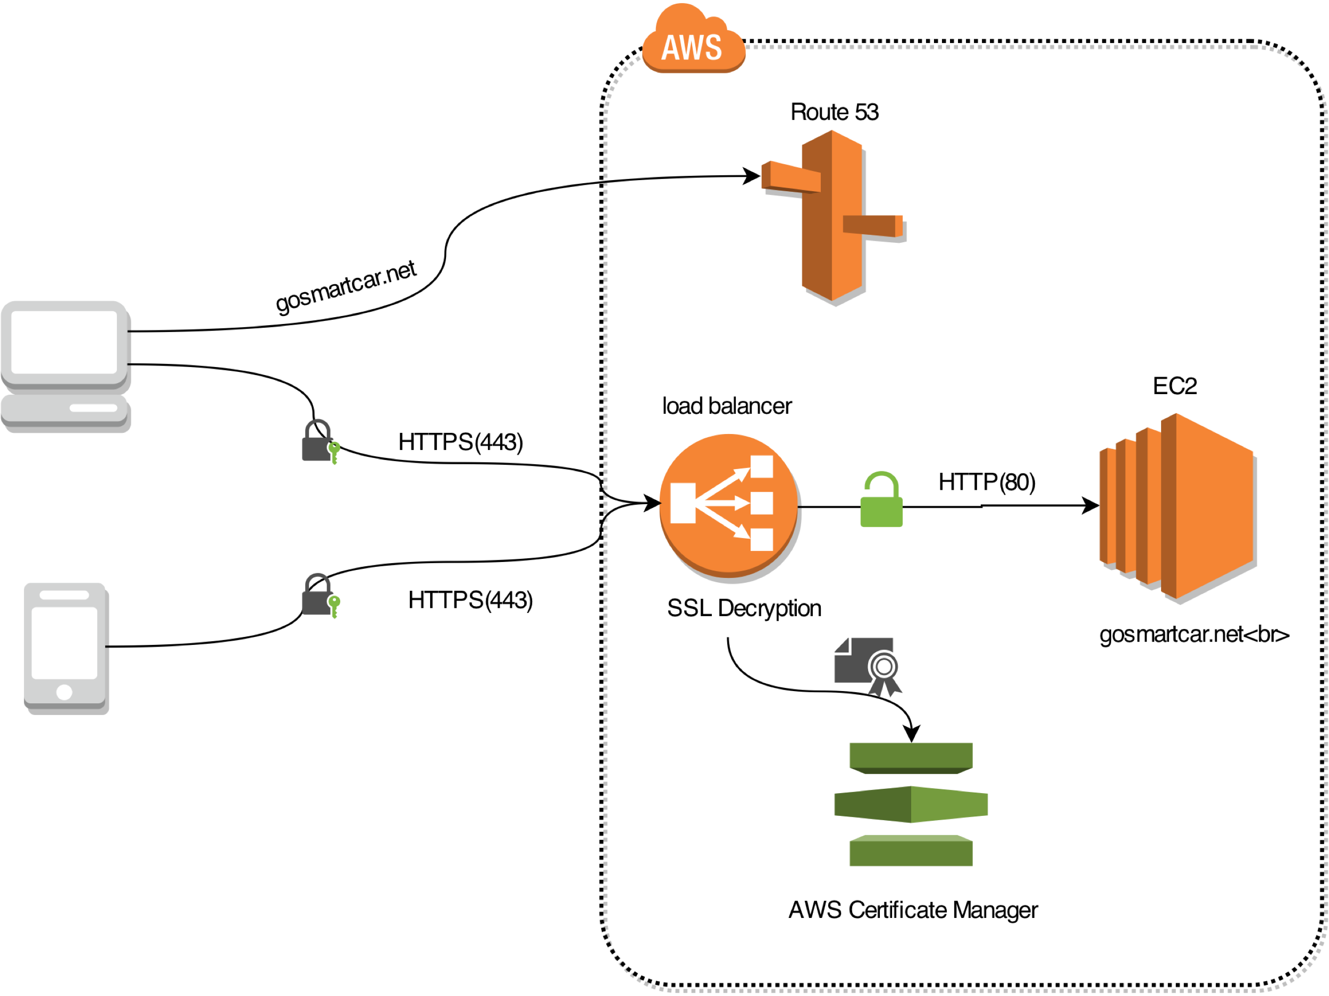
Deploying HTTPS
Notes:
Route53 for the management of the domain’s zone
AWS Certificate Manager for the SSL/TLS certificate of the domain

Slide 27
Challenges Encountered
Building Application from the scratch
Dealing with AWS
Streaming live video

Slide 28
Summary
* Acquaintance with AWS.
* Software-hardware integration.
* Rapid implementation and deployment using AWS services.

Slide 29
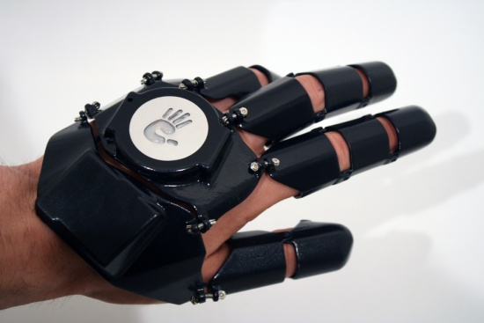
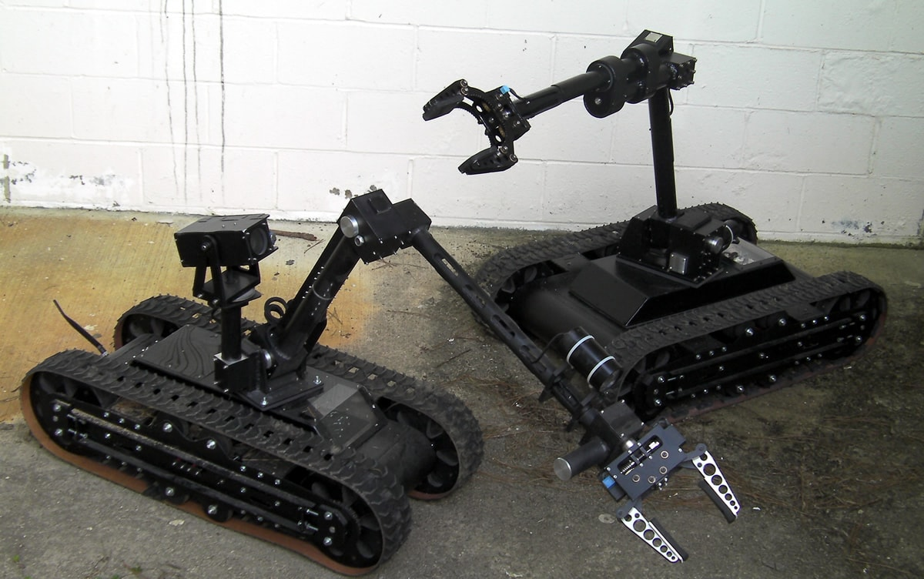
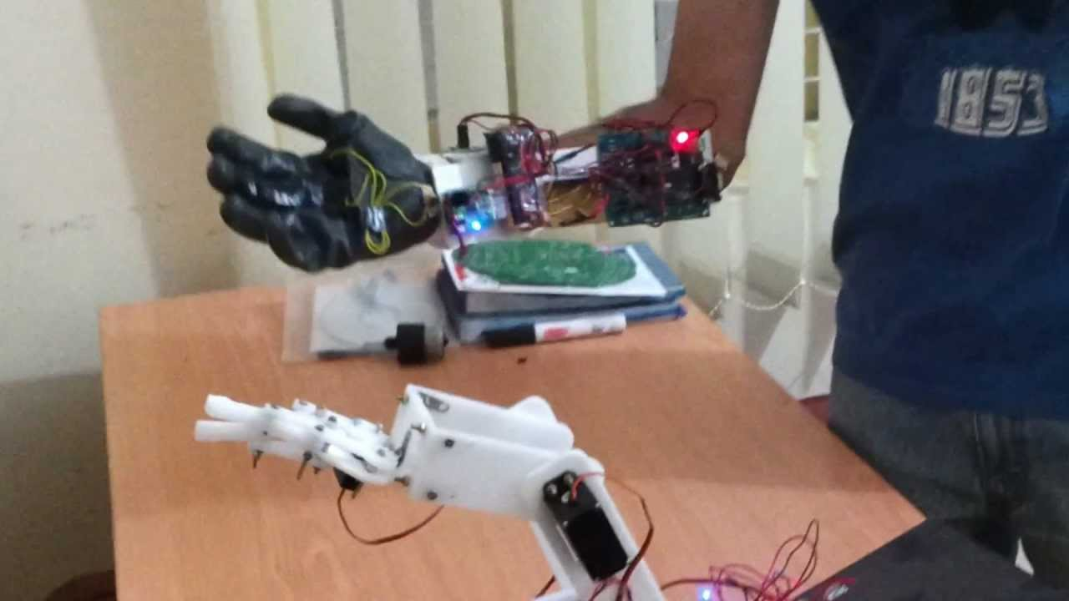
Continuing project ?!!

Slide 30

QUESTIONS

Slide 31

The
end

